Slide 1
Rain in Australia
11.07.2024
Hand-on-Machine Learning 2024 – Project presentation
Ali Guliyev & Denis Hoti

Slide 2
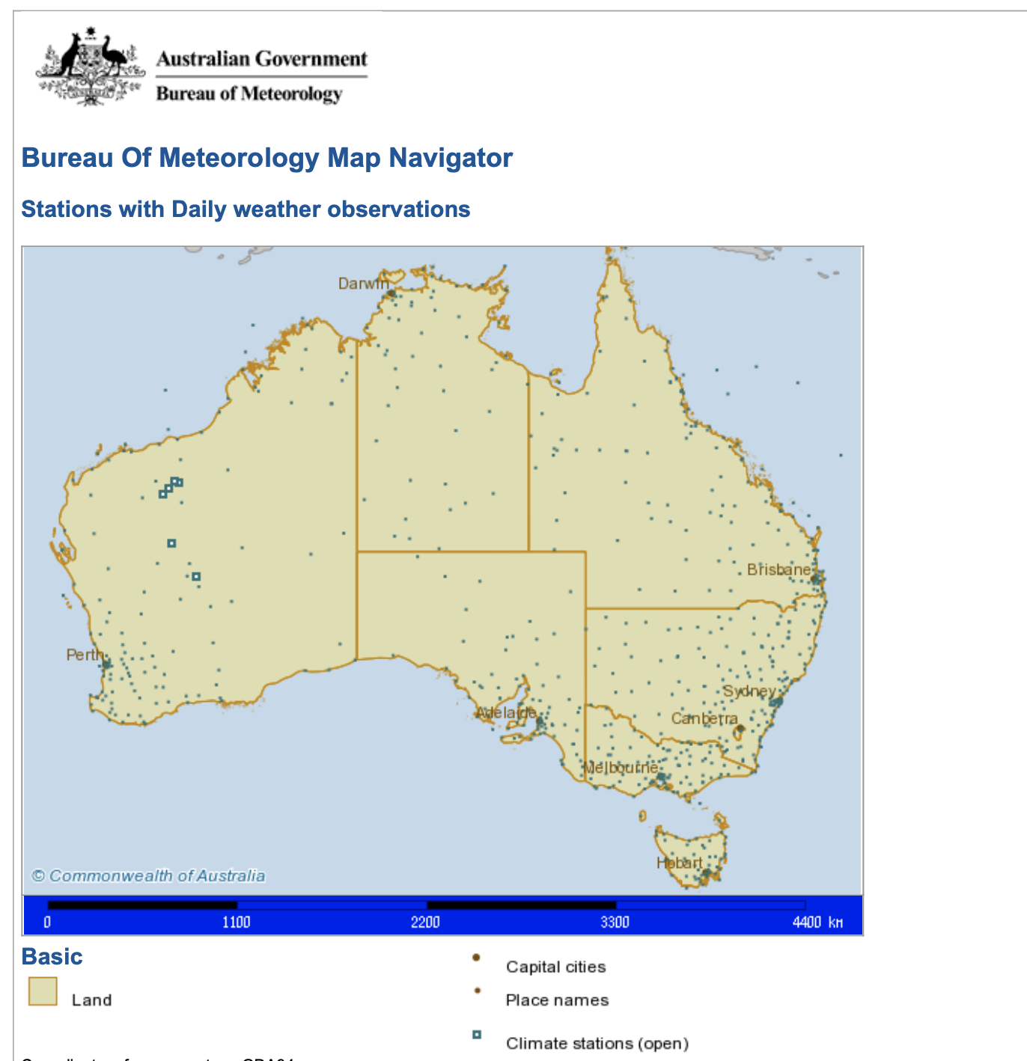
The Dataset
The “Rain in Australia” dataset is from Australian Government – Bureau of Meteorology, gathered from a multitude of weather stations.
Data consists about 10 years of daily weather observations, from 1st of November 2007 up to 25th of June 2017. It contains data from numerous locations across Australia.
Dataset consist of 145,000 instances and has 23 features (attributes).
These attributes are: Date, Location, MinTemp, MaxTemp, Rainfall, Evaporation, Sunshine, WindGustDir, WindGustSpeed, WindDir9am, WindDir3pm, WindSpeed9am, WindSpeed3pm, Humidity9am, Humidity3pm, Pressure9am, Pressure3pm, Cloud9am, Cloud3pm, Temp9am, Temp3pm, RainToday, RainTomorrow

Slide 3
The attributes
Attribute | Unit | Meaning
Date | yyyy-mm-dd | The date of observation
Location | City Name | The name of the location of the weather station
MinTemp | Degrees Celsius (°C) | The minimum temperature
MaxTemp | Degrees Celsius (°C) | The maximum temperature
Rainfall | Millimetre (mm) | The amount of rainfall recorded for the day
Evaporation | Millimetre (mm) | It's the process that changes a substance from a liquis into a gas or vapor
Sunshine | Number of hours | The number of hours of bright sunshine in the day
WindGustDir | Cardinal Directions | The direction of the strongest wind gust in the 24 hours to midnight

Slide 4
Attribute | Unit | Meaning
WindGustSpeed | km/h | The speed of the strongest wind gust in the 24 hours to midnight
WindDir9am | Cardinal Directions | Direction of the wind at 9am
WindDir3pm | Cardinal Directions | Direction of the wind at 3pm
WindSpeed9am | km/h | Wind speed average over 10 minutes prior to 9am
WindSpeed3pm | km/h | Wind speed average over 10 minutes prior to 3pm
Humidity9am | Percentage (%) | It shows the amount of water vapor in the air at 9am
Humidity3pm | Percentage (%) | It shows the amount of water vapor in the air at 3pm
Pressure9am | Hectopascal (hPa) | Atmospheric pressure reduced to mean sea level at 9am
Pressure3pm | Hectopascal (hPa) | Atmospheric pressure reduced to mean sea level at 3pm
Cloud9am | Oktas (a unit of Eighths) | It records how many eighths of the sky are obscured by cloud. A 0 measure indicates completely clear sky whilst an 8 indicates that it is completely overcast.
Cloud3pm | Oktas (a unit of Eighths) | Fraction of sky obscured by cloud at 3pm
Temp9am | Degrees Celsius (°C) | Temperature at 9am
Temp3pm | Degrees Celsius (°C) | Temperature at 3pm

Slide 5
Attribute | Unit | Meaning
RainToday | Boolean: 1 (True) or 0 (False) | True if precipitation (mm) in the 24 hours to 9am exceeds 1mm otherwise False
RainTomorrow | Boolean: 1 (True) or 0 (False) | If in the next day there was any precipitation (mm) exceeds 1mm otherwise False

Slide 6
The problem
Questions: Will it rain tomorrow or not? Should you carry an umbrella tomorrow or not? May we simplify the dataset by trimming some uncorrelated features?
The dataset is very unbalanced, and also has a lot of missing values.
Split of the dataset is decided as 65% train, 15% validation and 20% test sets.
In this dataset metrics are F1, Recall and Precision scores. Aim is maximize F1 and Recall scores while not dropping Precision too much.

Slide 7
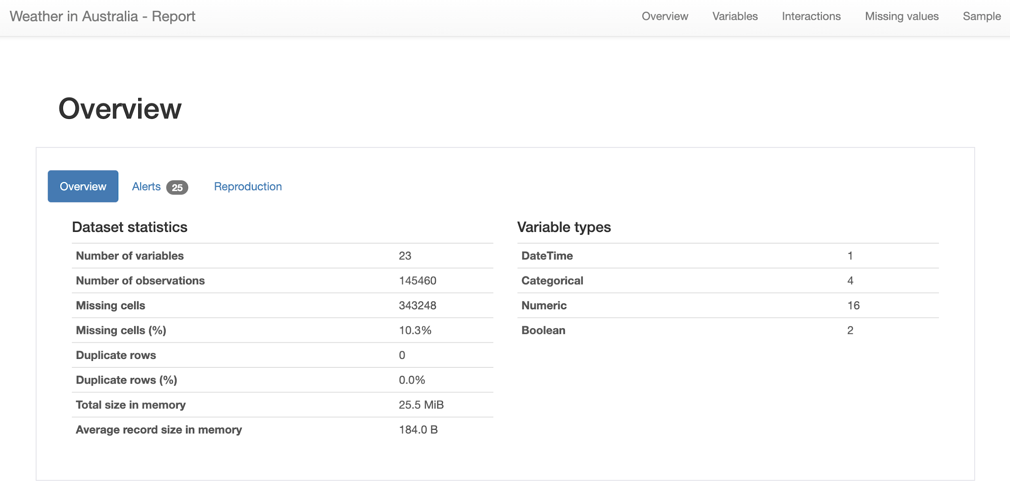
Analyzing the features
For analyzing the dataset: ydata-profiling – Profile Report

Slide 8
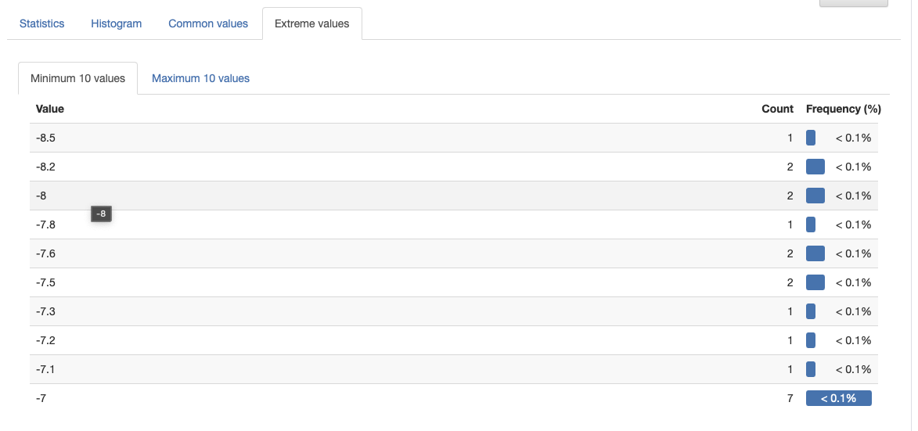
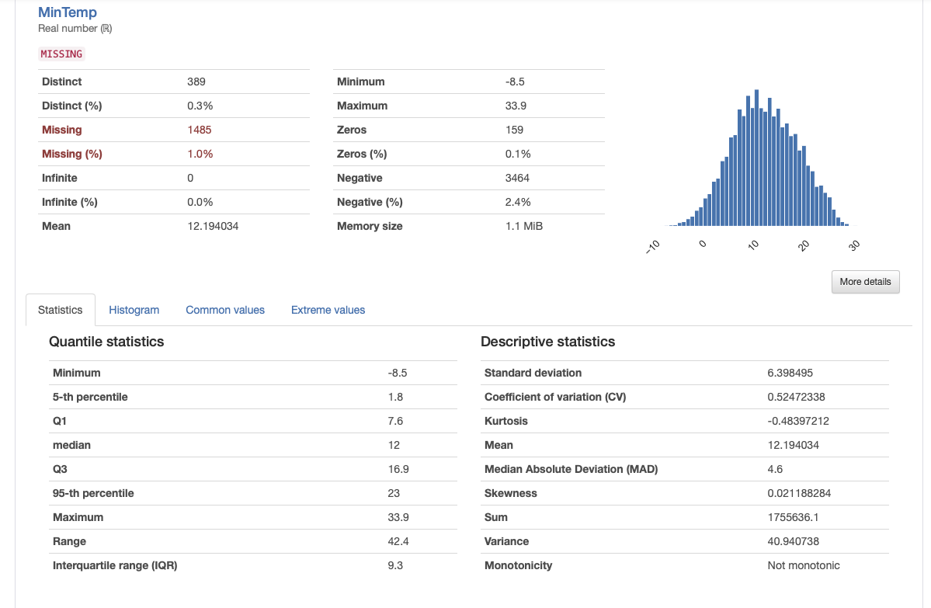
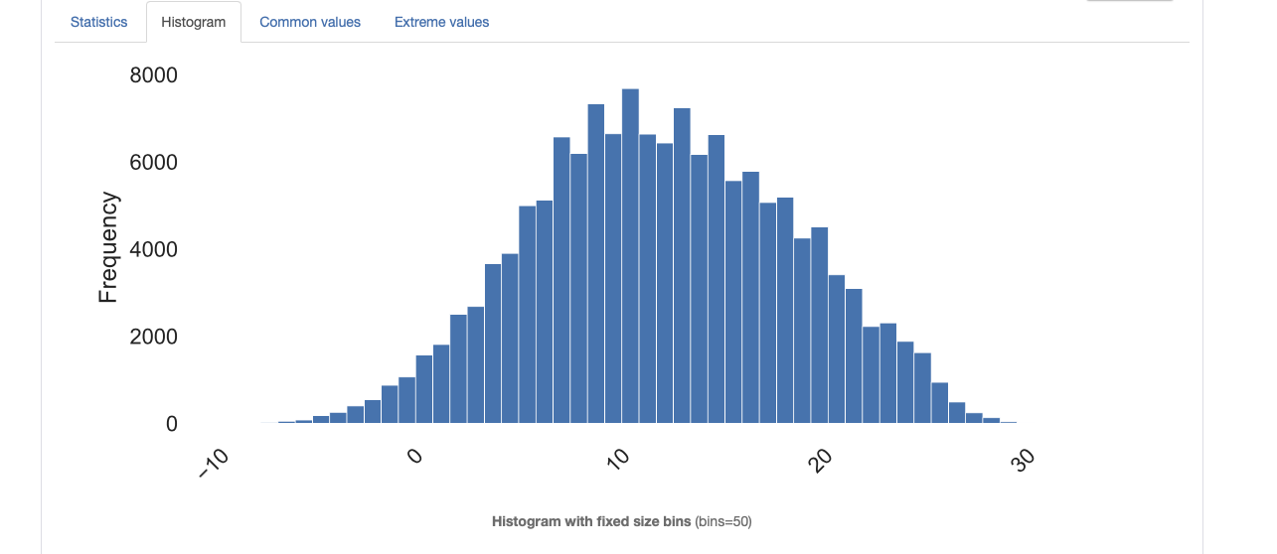

Slide 9
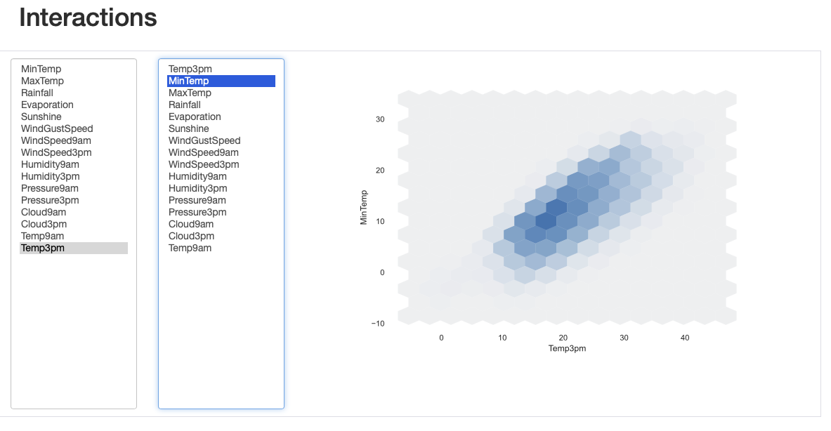
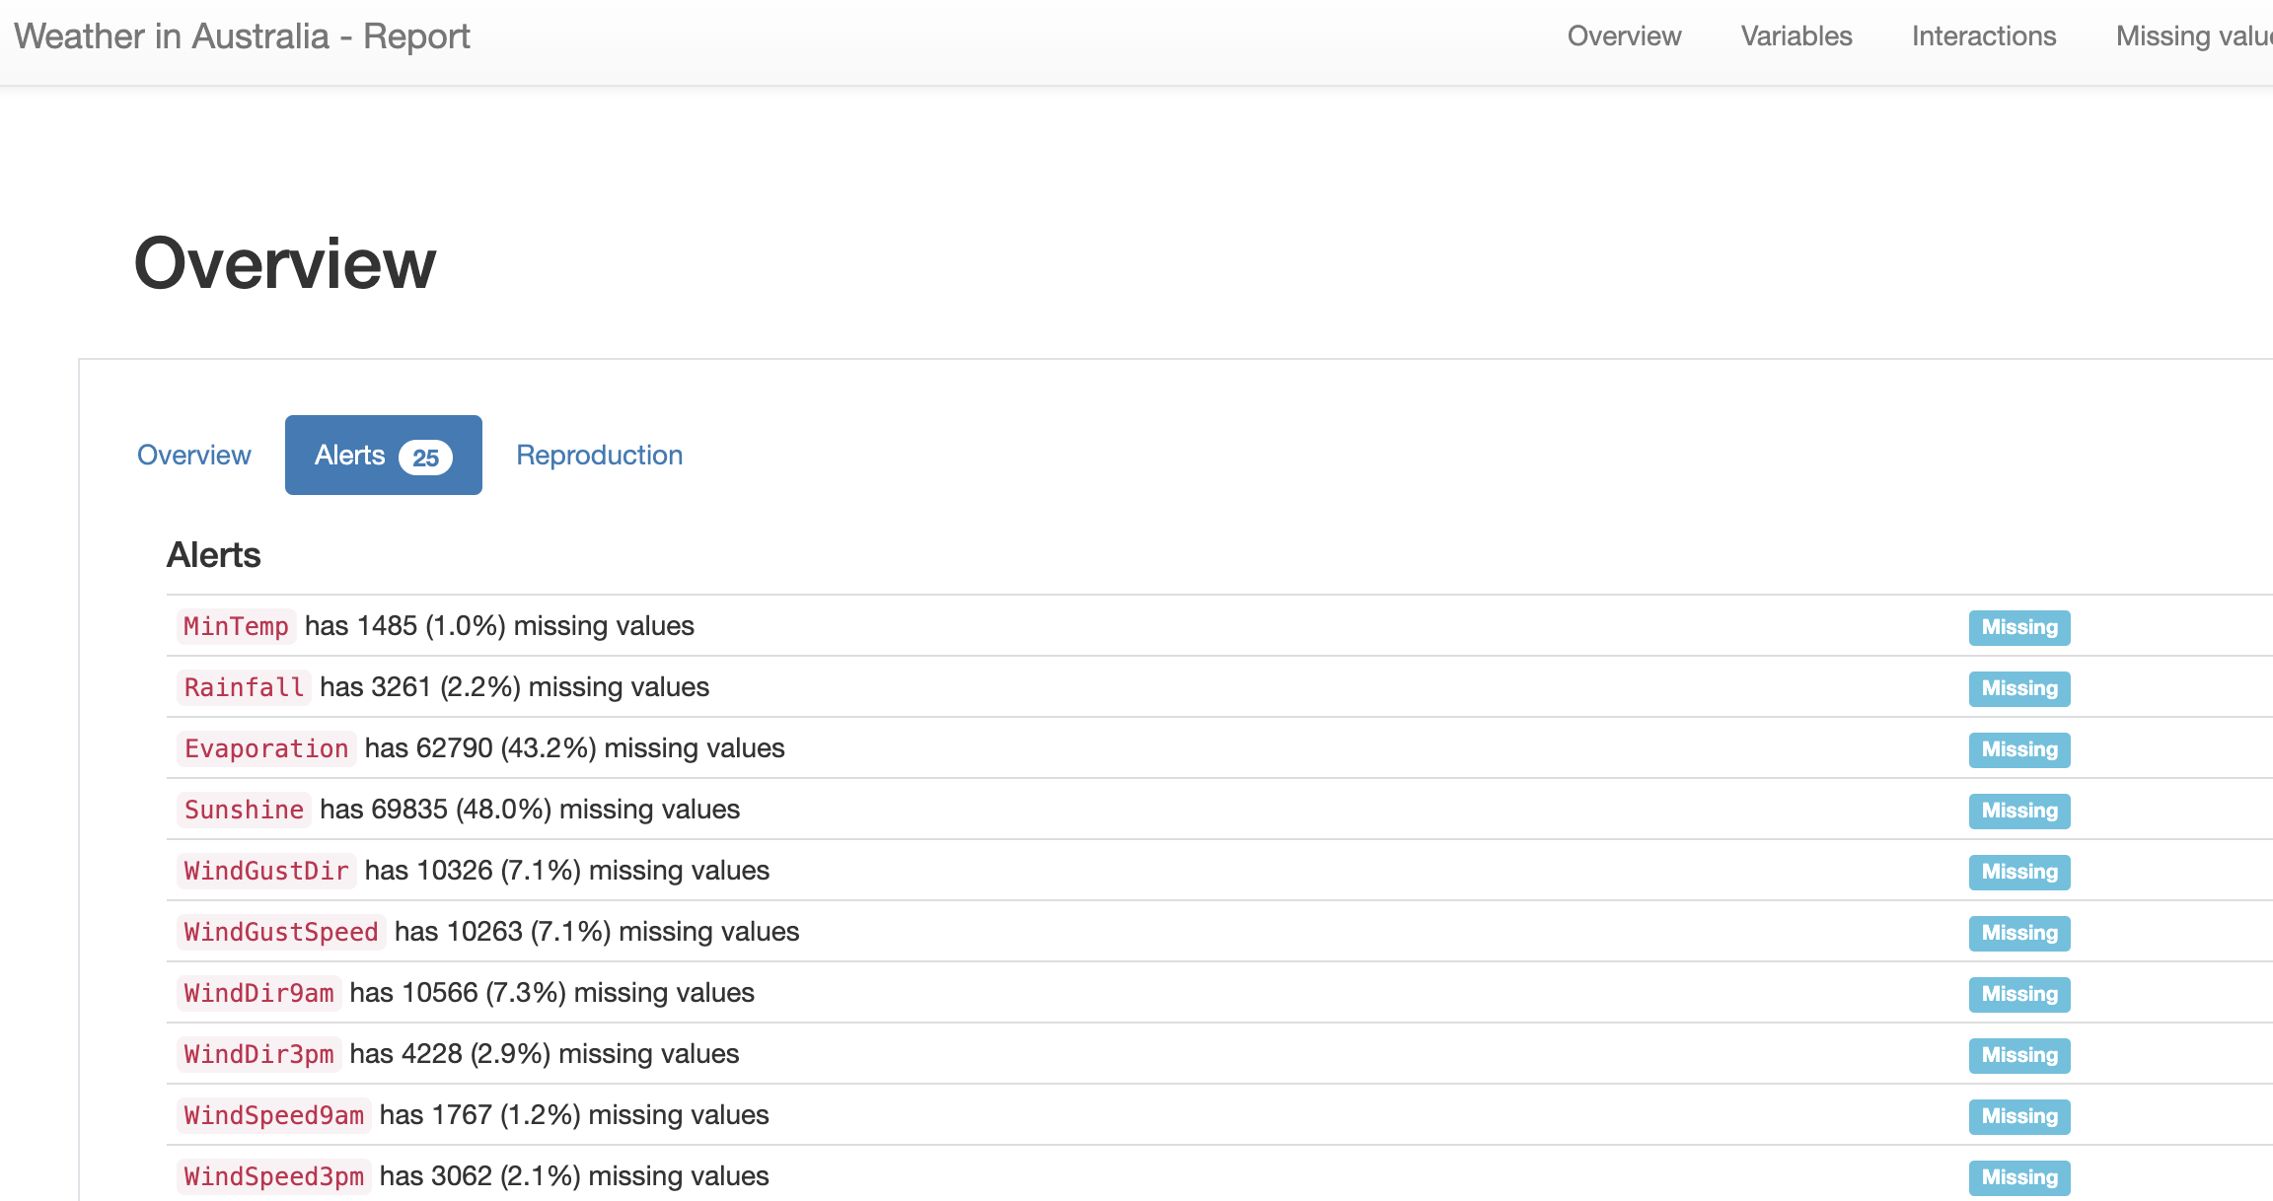
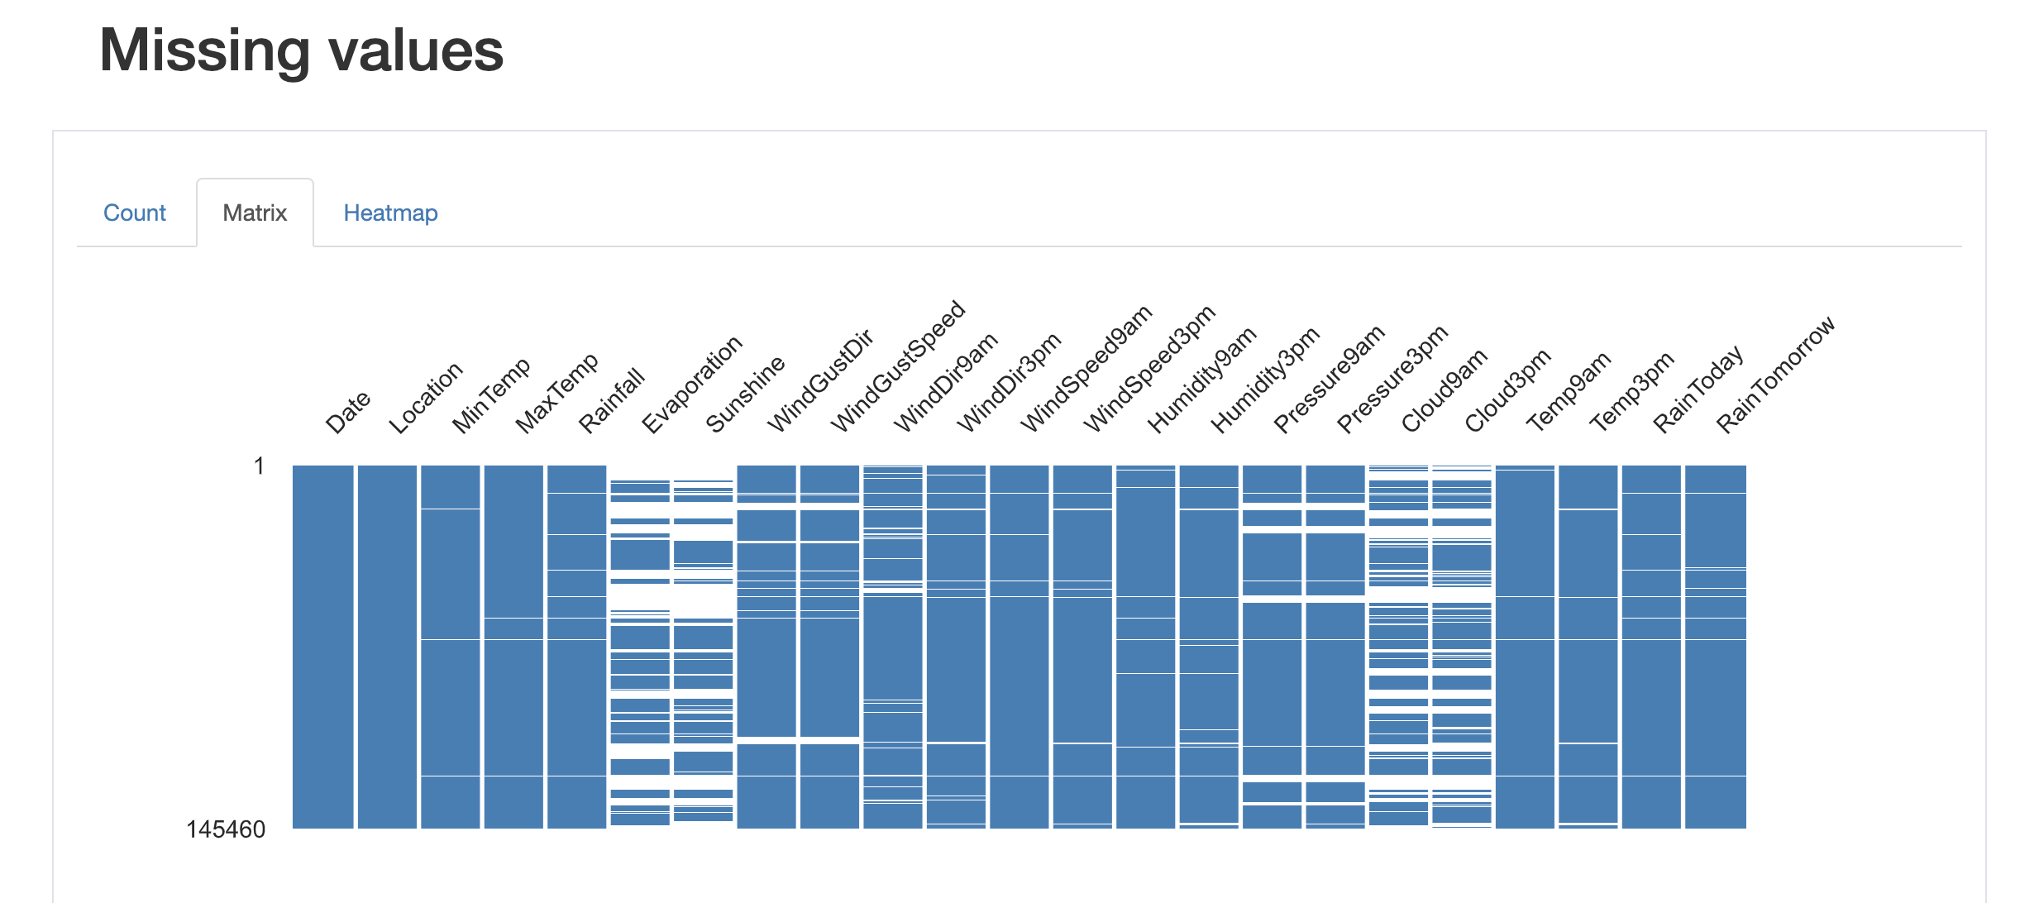

Slide 10
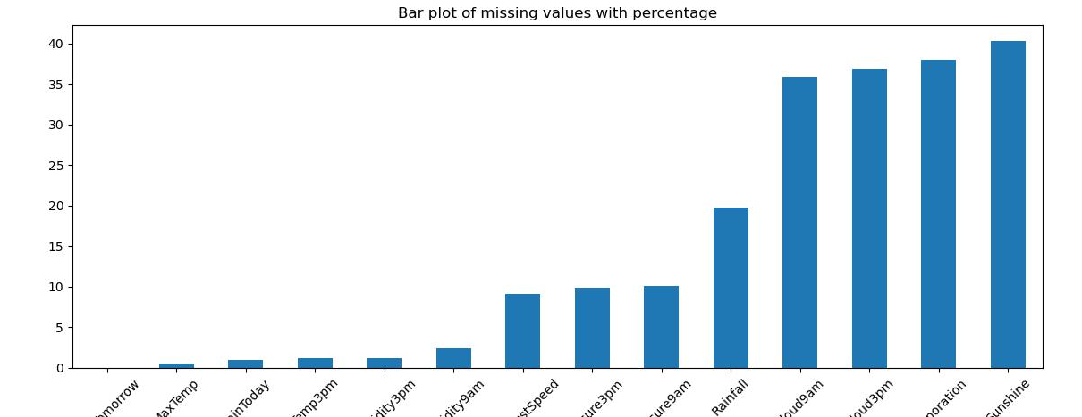
Missing values
From the report we could see that we really have a considered amount of missing data.
We will use a fancy way of imputing missing data using lightgbm

Slide 11
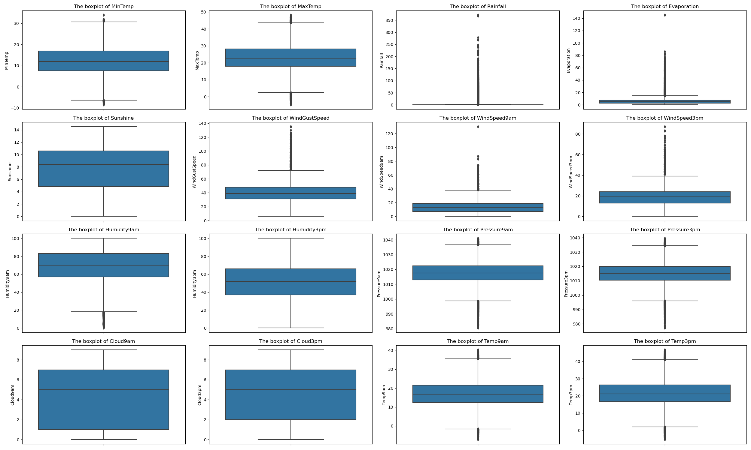
Outliers

Slide 12

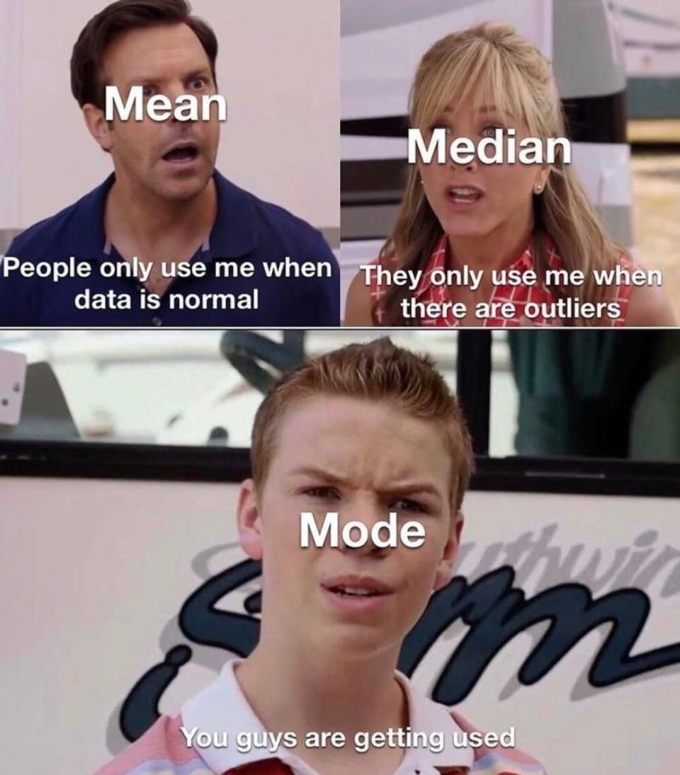
How do we handle outliers?

Slide 13
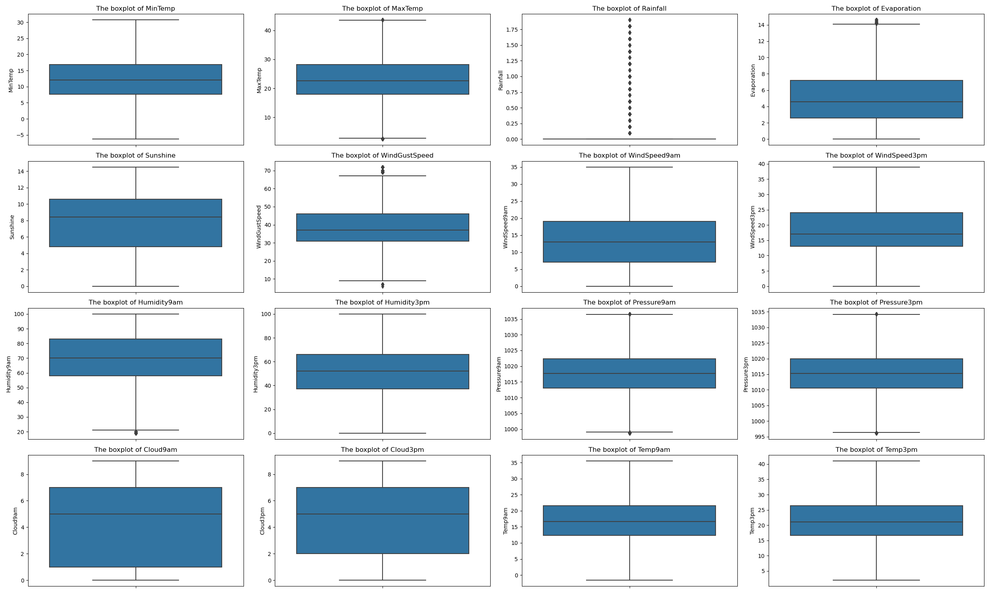
After removing outliers

Slide 14
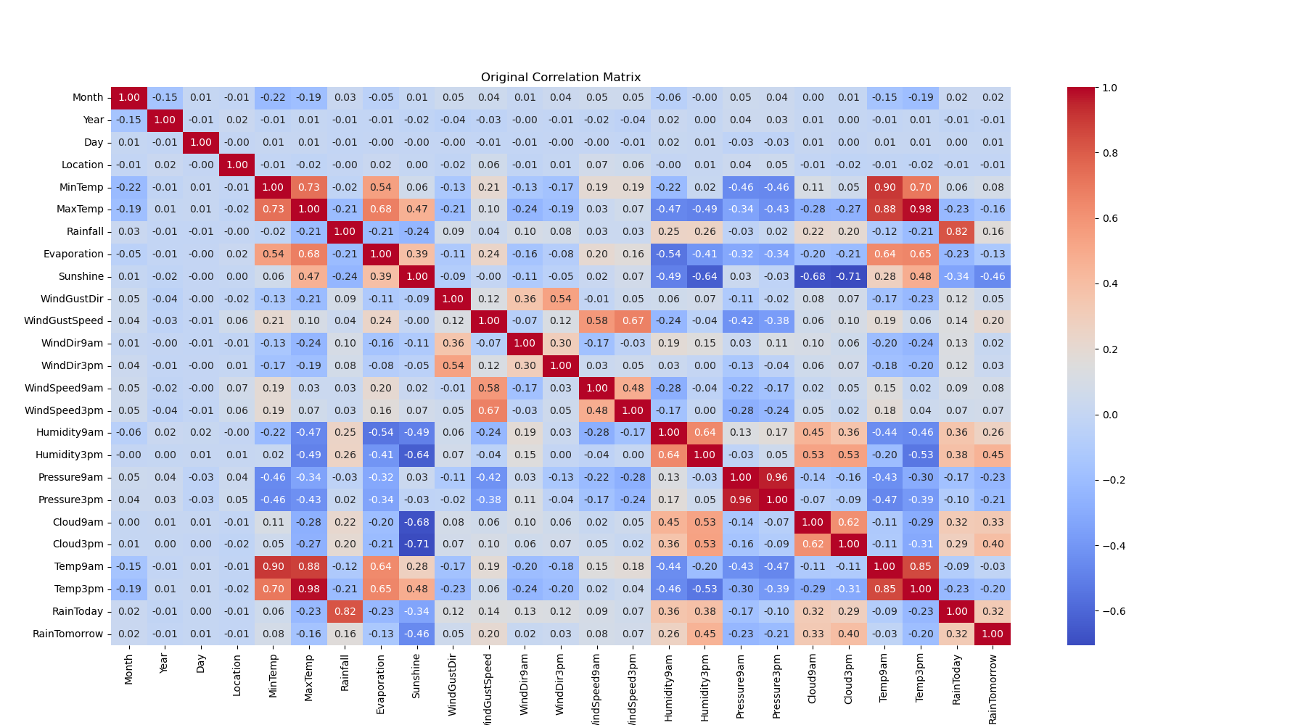
Original Correlation Matrix - 25 features

Slide 15
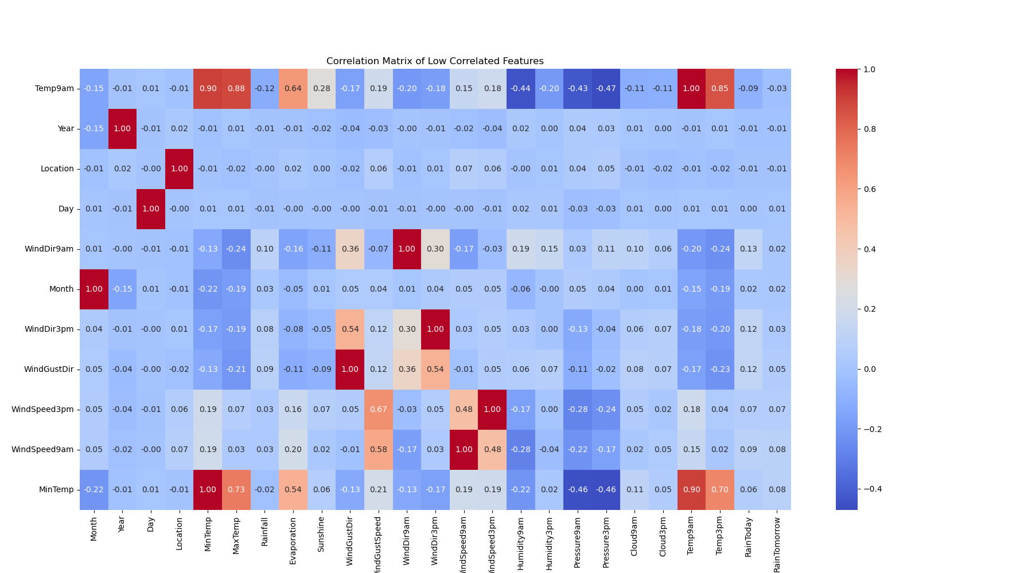
Correlation Matrix of dropped features - 11 features

Slide 16
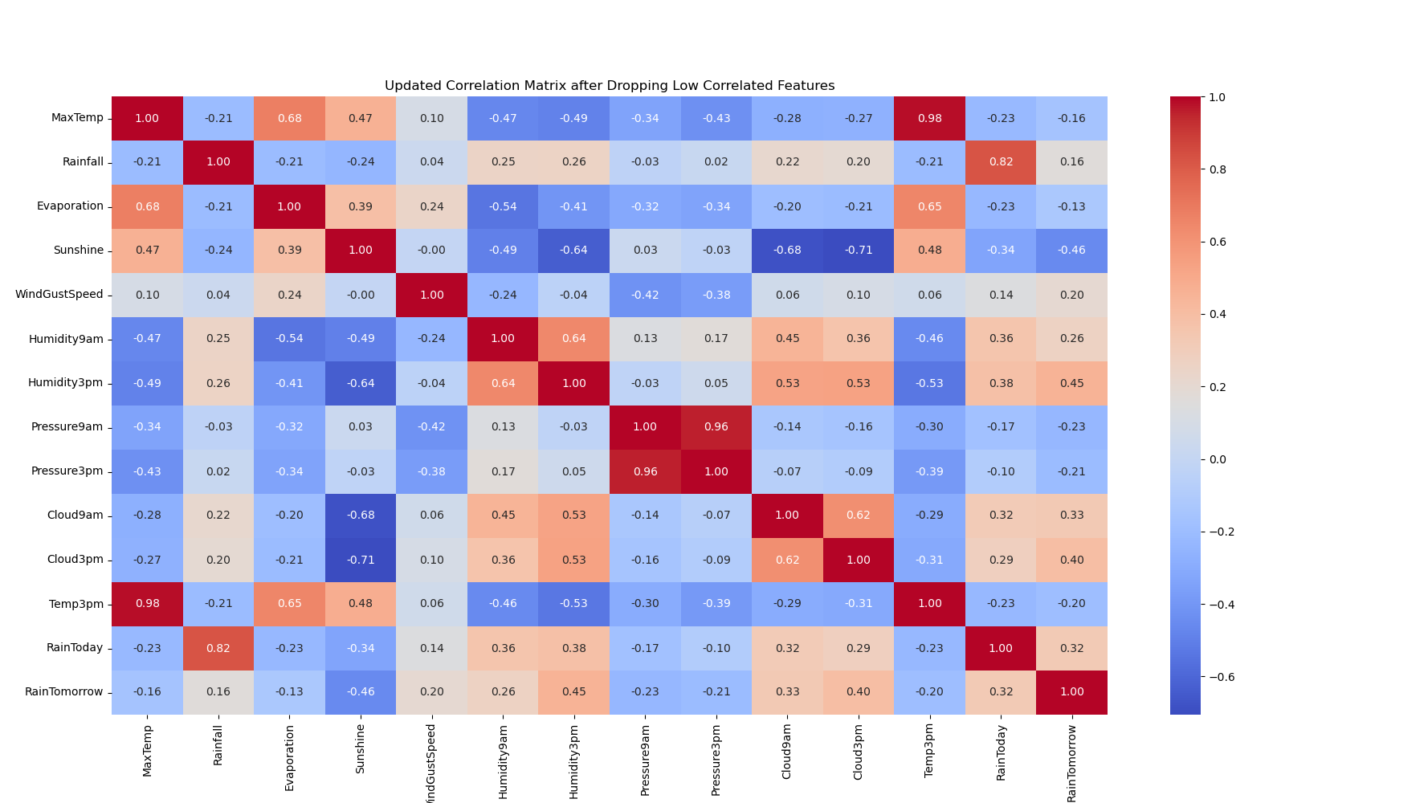
Correlation Matrix after dropping uncorrelated features - 14 features

Slide 17
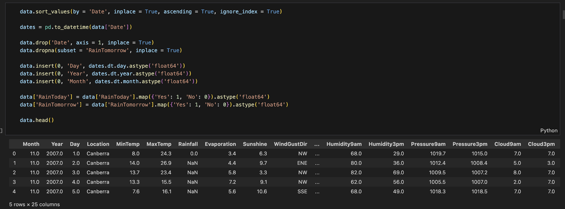
Data Encoding
First, we encode the date to Month, Year and Date
We drop all the missing values of our target column (2.2%)
Then we encode RainTomorrow and RainToday into Boolean values (Float 0 and 1)

Slide 18
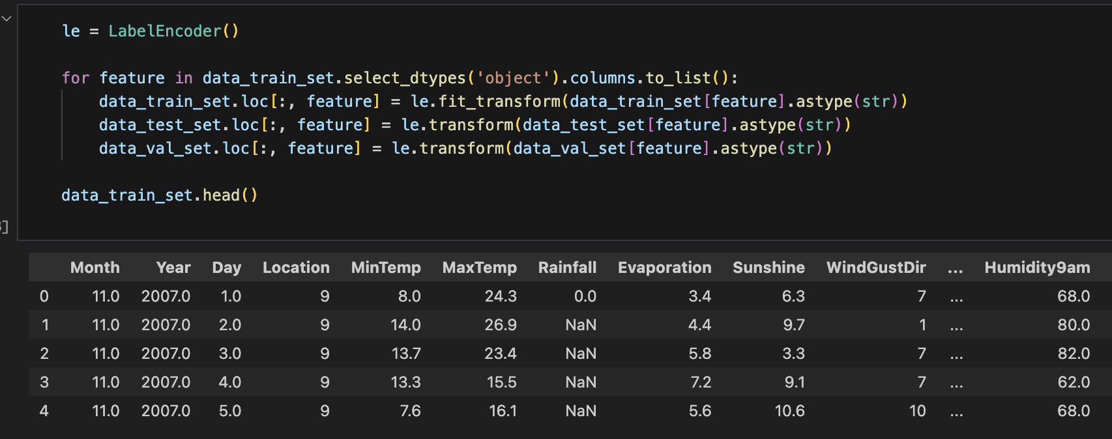
Data Encoding II
Encoding categorical features via LabelEncoder which basically express them with numbers.
We will use LabelEncoder from the scikit-learn library, which is a good practice for preparing the data for a machine learning model that requires numerical inputs. It handles the categorical data efficiently.

Slide 19
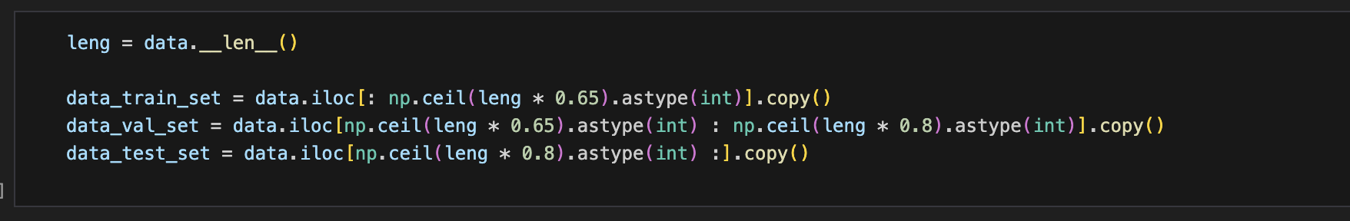
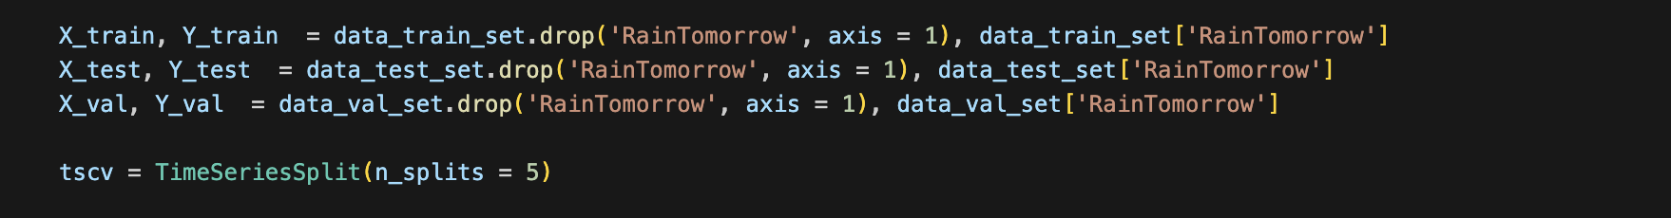
Data Splitting
We split our data into 3 data sets:
Training set, used to train the machine learning model (0 – 65%)
Validation set, used to fine-tune the model's hyperparameters and prevent overfitting (65 – 80%)
Testing set, used to evaluate the model’s performance on unseen data (80 – 100%)
We use TimeSeriesSplit

Slide 20
Imputation of Missing Values with
LightGBM

Slide 21
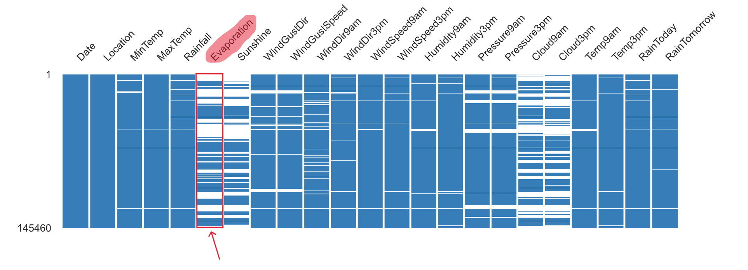
LightGBM - Light Gradient-Boosting Machine
As an example, our algorithm take Evaporation column as a target and train model with all other features. Then predict missing values and merge into target column. Of course, the algorithm make a distinction among binary, multiclass, continuous features and adjust parameters.

Slide 22
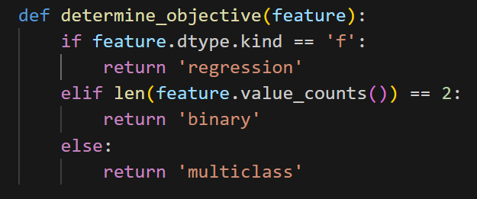
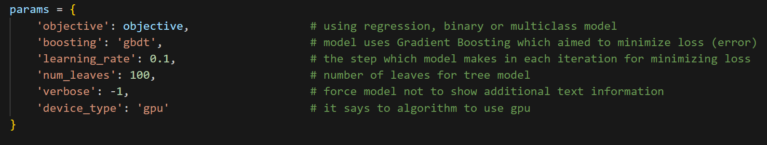
Basic parameter tuning for LightGBM
Note: We train models where there is at least one missing value (in whole column) and then add that model into an array to input missing values of train, validation and test sets. To prevent data leakage those models are trained only on the train set.

Slide 23
Models
KNN
Logistic Regression
Random Forest
XGBoost
Neural Network
Ensemble method (Voting)

Slide 24
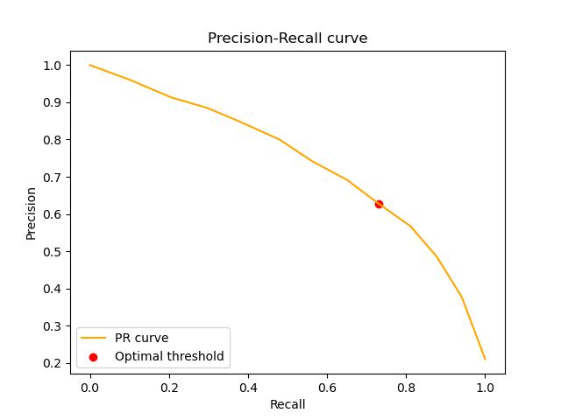
KNN - K Nearest Neighbors
The best hyperparameter (n_neighbors) is 11 for given dataset. While knn is a bit simpler model compare to the rest of models, however, it performs better than LogisticRegression.
 | Recall | Precision | F1
Train: | 0.6492 | 0.8010 | 0.7171
Validation: | 0.5626 | 0.7415 | 0.6398
Threshold: | 0.7300 | 0.6281 | 0.6752

Slide 25
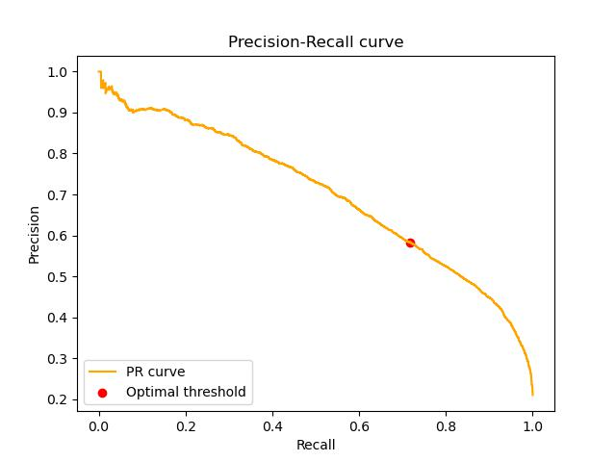
Logistic Regression
As we mentioned results are slightly worse than KNN. One can think about the wrong choice of hyperparameters because generally, this model is not bad. Therefore, we put a snippet that shows the range of hyperparameters our model goes through.
 | Recall | Precision | F1
Train: | 0.8013 | 0.5536 | 0.6548
Validation: | 0.7603 | 0.5516 | 0.6393
Threshold: | 0.7182 | 0.5834 | 0.6438

Slide 26
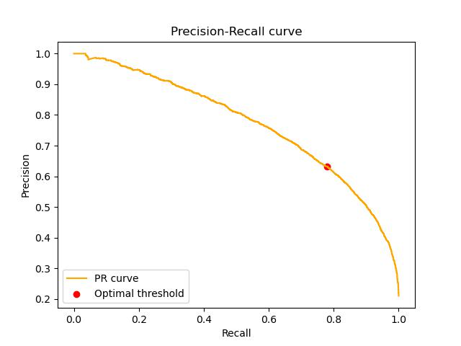
Random Forest
Now we have tree-based models that perform well in most cases. Looks like this model makes a bit of overfitting, however, we think that is natural in our case because according to Cross-Validation these are the best results on the selected validation set, and also the found hyperparameters are not “too” complicated to train some deep trees.
 | Recall | Precision | F1
Train: | 0.9091 | 0.7211 | 0.8042
Validation: | 0.7483 | 0.6521 | 0.6969
Threshold: | 0.7802 | 0.6317 | 0.6982

Slide 27
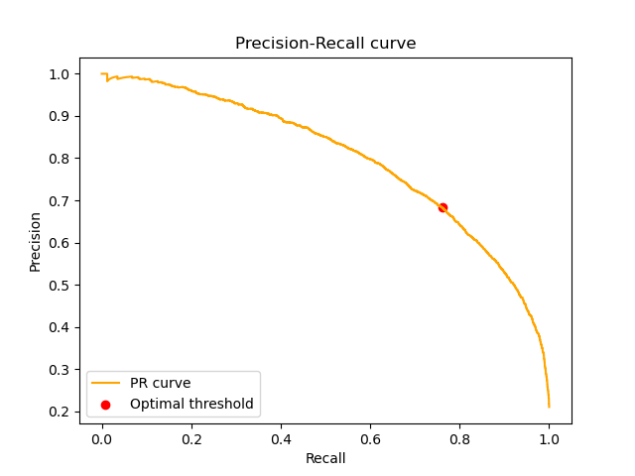
XGBoost - Extreme Gradient Boosting
XGBoost is a really powerful tool and one can use it for many problems. In our case, we got the best results with this model. One thing that we must mention is this model took more than 2300 minutes which makes it a winner in the category of most time-taken models together with the best results.
 | Recall | Precision | F1
Train: | 0.8959 | 0.7453 | 0.8137
Validation: | 0.7568 | 0.6863 | 0.7198
Threshold: | 0.7610 | 0.6834 | 0.7201

Slide 28
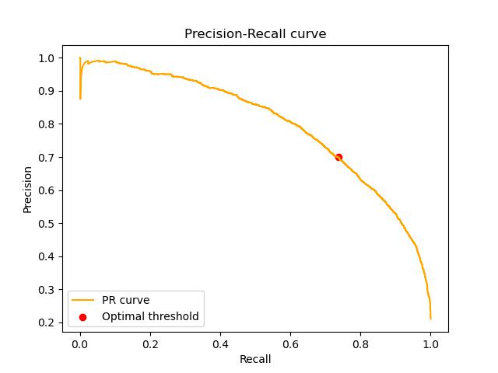
MLP - Neural Network
Nothing needs to be said, milestone of Machine Learning models! Aside from a joke, Neural Network models also take a long training time because of the complexity and wide spectrum of hyperparameters. As you can see, the results are almost the same with the XGBoost.
 | Recall | Precision | F1
Train: | 0.6555 | 0.7854 | 0.7146
Validation: | 0.6175 | 0.7958 | 0.6954
Threshold: | 0.7373 | 0.6990 | 0.7176

Slide 29
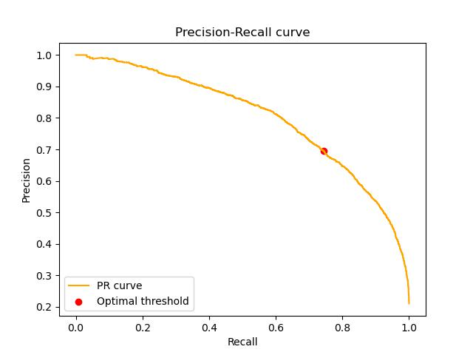
Voting - Ensemble Method
This model is nothing but a collaboration of other models. Here we take RandomForest, NeuralNetwork, XGBoost models and ask the prediction to each individually, then vote among their outcomes. The reason behind ignoring other models is that they affect general results in a worse way. Unfortunately, democracy is not always the solution.
 | Recall | Precision | F1
Train: | 0.8276 | 0.7694 | 0.7975
Validation: | 0.7032 | 0.7255 | 0.7142
Threshold: | 0.7440 | 0.6959 | 0.7192

Slide 30
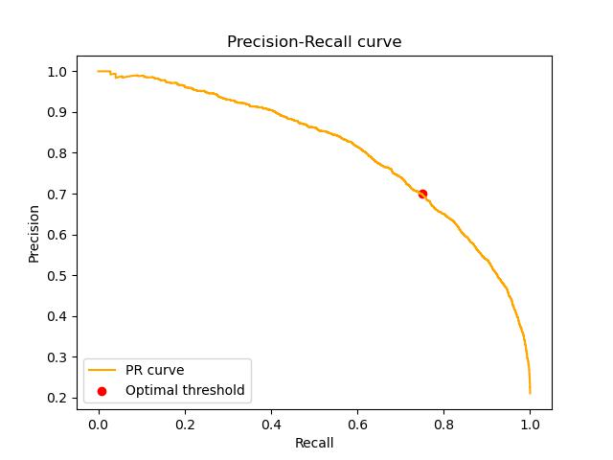
Evaluation on Test Set
Now roughly saying, we have entered the cage of the lion. Here we evaluate the test set which we have packed and put away before, on the previous voting model. This picture illustrates general picture of our project.
 | Recall | Precision | F1
Train: | 0.8305 | 0.7674 | 0.7977
Validation: | 0.7584 | 0.7333 | 0.7456
Threshold: | 0.7948 | 0.7012 | 0.7451

Slide 31
Thanks for your attention!
Lastly, we have learned a lot during the project and the whole semester. Therefore, we would like to thank especially Paul Geuchen & Prof. Felix Voigtlaender.
Presented by Denis Hotii & Ali Guliyev

